Slide 1
Prometheus

Slide 2
Intro
Prometheus is a free open-source monitoring system
Dedicated querying through Prom-QL
UI comes with graphing/table visualization, but data source can be added for persisting visuals in Grafana
UI comes with alerting (slack, email, etc). Can also alert through Grafana.
Prometheus implements native Kubernetes-based service discovery, meaning that it can discover pods, endpoints, services, and so on, in Kubernetes clusters.

Slide 3
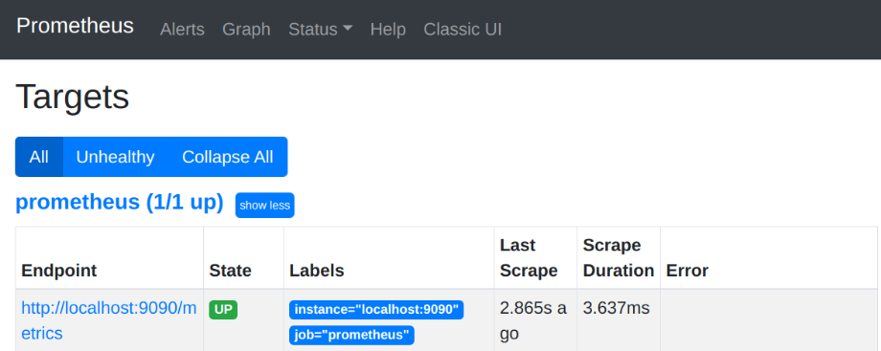
Setup
wget tar file from github
Edit configuration yml
Run “./prometheus” to start
Making highly available and persisting data long term adds complexity

Slide 4
Prom-ql and Grafana

Slide 5

Node exporter
Exposes metrics about the Linux host it is running on (memory, CPU, disk and network traffic)
Run Prometheus on its own dedicated server
Run Node exporter on every server you want to monitor and then Prometheus scrapes the exporter
wget node exporter from github and run “./node_exporter” to start
Run “kilall –HUP prometheus” to reload
Can also write own exporters for more complex tasks (monitoring 3rd party services, etc)

Slide 6
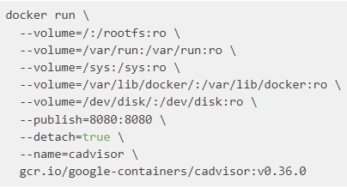

Container Metrics
Uses cAdvisor from Google as an exporter
Prometheus then scrapes the given target
Can filter Prom-QL query, but changing {job=“cadvisor”}
Provides Podman monitoring

Slide 7
Service discovery
Built-in support for discovering services
Cloud and VM Providers
Cluster schedulers (Kubernetes)
Generic mechanisms (DNS, Consul, etc)
File based custom service discovery

Slide 8
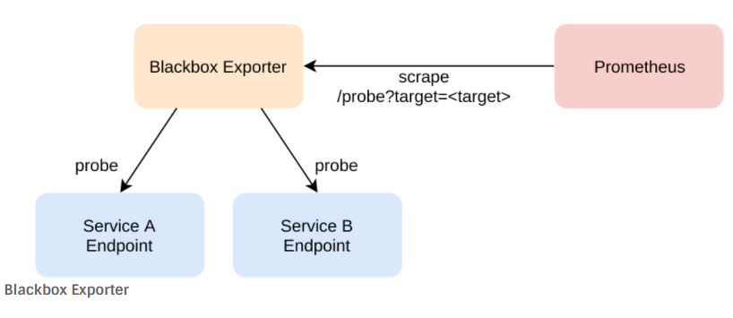
Blackbox monitoring
Blackbox Exporter probes using HTTP(S), DNS, TCP, ICMP
Prometheus has a blackbox exporter on github
Configured through “blackbox.yml”

Slide 9
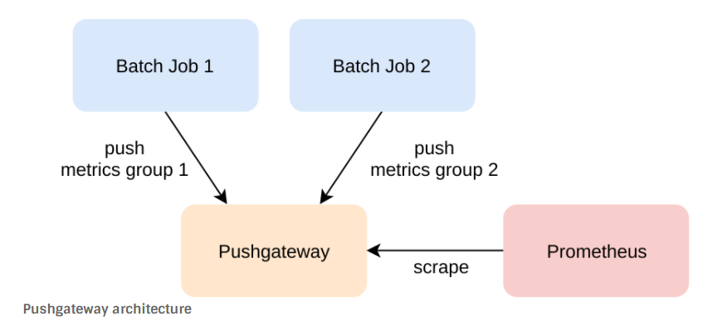
Pushgateway

Slide 10
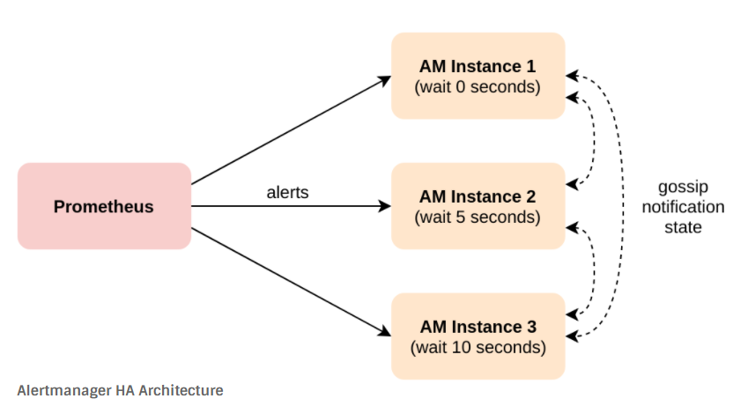
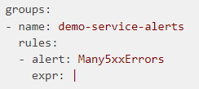
Alerting
Recommended to make Highly Available with multiple instances
Alertmanager can be downloaded from Prometheus github, extracted and run
Requires a rules.yml file

Slide 11
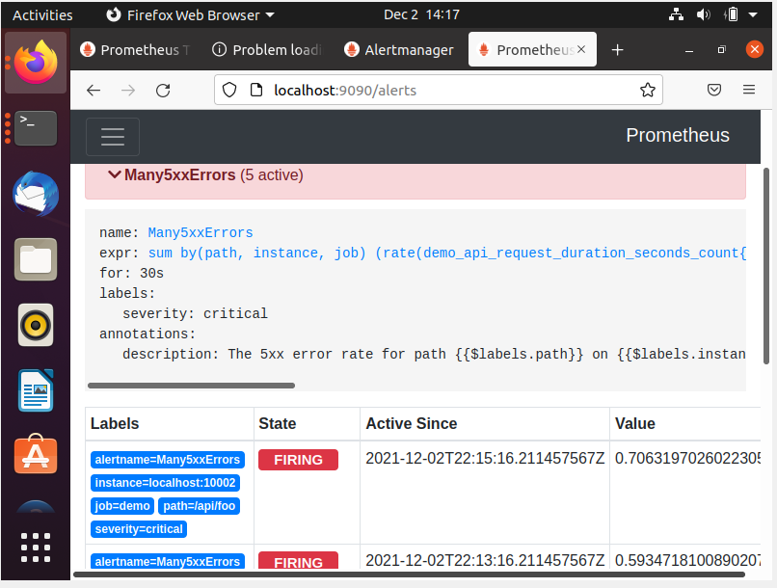
Alerting example

Slide 12
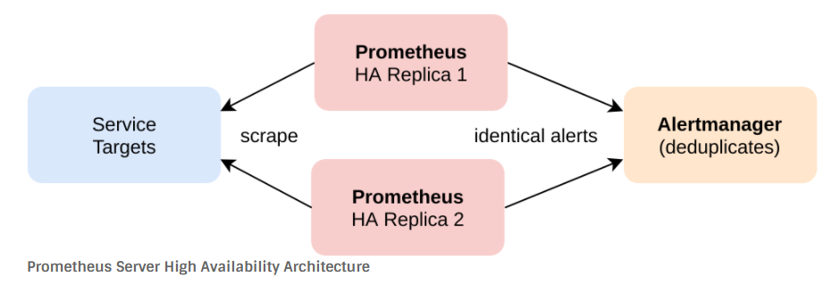
High Availability
Setting up exact replicas on separate servers recommended
All Prometheus instances scrape same data
Alertmanager deduplicates alerts
Manual or Load-balancing switchovers

Slide 13
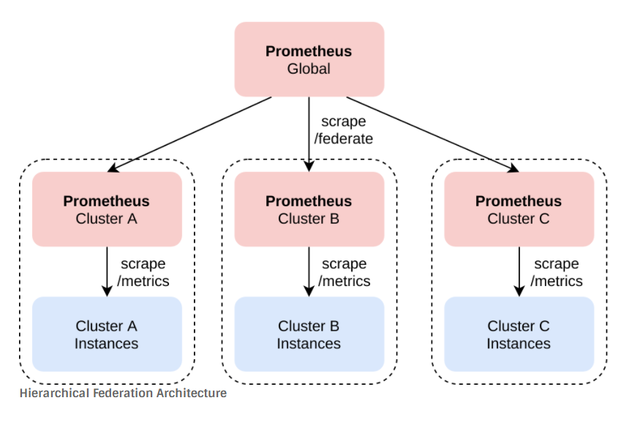
scaling

Slide 14
kubernetes
Prometheus was designed for monitoring cluster schedulers
Kubernetes cluster components (API Server, Kubelet, Etcd, DNS server) expose native Prometheus metrics endpoints
Prometheus implements native Kubernetes-based service discovery (discover pods, endpoints, services, etc.)
Running Prometheus inside Kubernetes cluster, it automatically gets the right credentials mounted into its container
Running Prometheus outside the Kubernetes cluster, you will need to provide Prometheus with the right credentials manually and also ensure it can reach the metrics endpoints of services running on the cluster

Slide 15
Kubernetes Continued
Prometheus Operator is a tool by CoreOS (Red Hat). It helps manage/automate Prometheus servers as well as supports managing highly available Alertmanagers on top of Kubernetes

Slide 16
Key takeaways
Pros:
Free and open source
Kubernetes/Container support
Dashboarding/Visualizations
Features and support
Simple to get started
Export option to Elasticsearch using Metricbeat Prometheus module
Cons
Learning curve
Designing and scaling things wrong initially will create headaches down the road
Time and maintenance to figure out queries, alerts, upgrading, etc.

